Slide 1




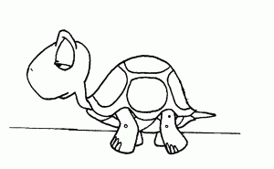
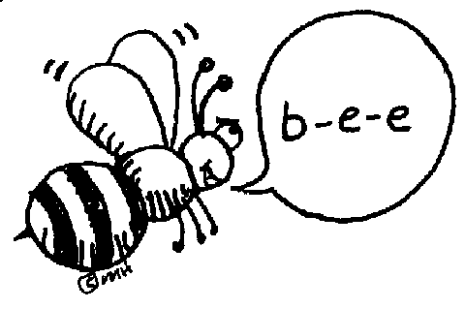


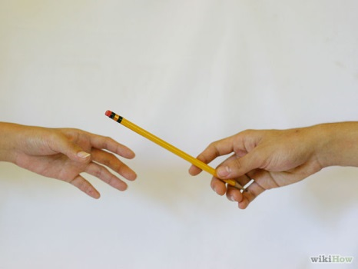

Slide 2
Please.

Slide 3
I’m sorry.

Slide 4
I don’t understand
Can you repeat, please?

Slide 5
How do you spell ...?

Slide 6
How do you say ... in Portugese?
How do you say ... In English?

Slide 7
Excuse me, teacher. I have a question.
Can you help me, please?

Slide 8
Can you speak slowly, please?

Slide 9
Thank you!
You’re Welcome!

Slide 10
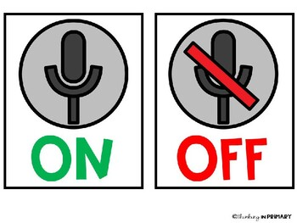
Microphones on/off, please.

Slide 11
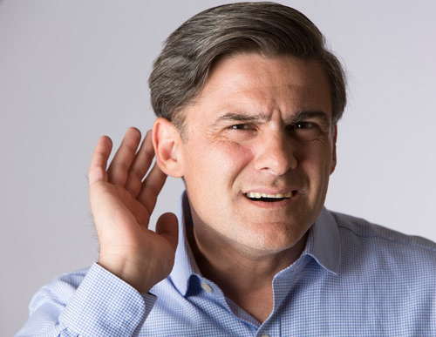
Excuse me, teacher. I can’t hear you.

Slide 12

Excuse me, teacher. I can’t see your screen.

Slide 13

Open your books.
What page, please?

